Slide 1
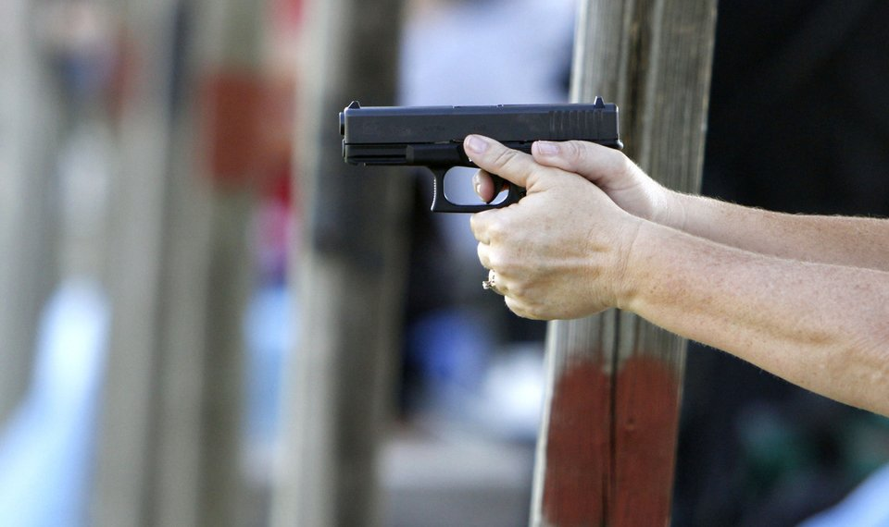

Firearms and Weapons
Oklahoma Title 21, Sec. 1289.24 – State Pre-Emption
  The State Legislature hereby occupies and pre-empts the entire field of legislation in this State touching in any way firearms, knives, components, ammunition, and supplies to the complete exclusion of any order, ordinance or regulation by any City.
  City may adopt ordinance relating to the discharge of firearms within its jurisdiction.
It is unlawful for any person to carry a concealed or unconcealed handgun in the State of Oklahoma, except as authorized by the provisions of the Oklahoma Self-Defense Act or as may otherwise be provided by law. (Title 21, Sec. 1290.4)
Handgun includes a pistol, derringer, revolver, or semiautomatic firearm which
  Has an overall barrel or barrels length of less than 16”’,
  Is capable of discharging single or multiple projectiles from a single round of ammunition composed of any materials which may reasonably be expected to be able to cause lethal injury,
  Can be held and fired by the use of one or both hands, and
  Uses a combustible propellant charge to propel the projectile or projectiles.

Slide 2
Firearms and Weapons
It is unlawful for any person in possession of a valid handgun license issued pursuant to the Oklahoma Self-Defense Act to carry any concealed or unconcealed handgun into any of the following places:
  Any structure, building, or office space which is owned or leased by a city for the purpose of conducting business with the public;
  Any publicly owned or operated sports arena or venue during a professional sporting event, unless allowed by the event holder;
  For the purposes of this section, the prohibited place does not include and specifically excludes the following property:
    Any property designated by a city authority as a park, recreational area, wildlife refuge, wildlife management area or fairgrounds; provided nothing in this paragraph shall be construed to authorize any entry by a person in possession of a concealed or unconcealed handgun into any structure, building or office space which is specifically prohibited by the provisions of this section.
    Oklahoma Statutes Title 21, Sec. 1277

Slide 3

Proposed City Ordinance
Municipal Code, Chapter 12, Offenses
Adopts State Statutes and Rules as now approved or hereinafter approved
Repeats language of State Statutes
It is unlawful to carry or transport:
  Sawed-off shotgun or sawed-off rifle;
  Concealed or unconcealed pistol or handgun except as authorized by the provisions of the Oklahoma Self-Defense Act or as may otherwise be authorized by law;
  To carry or wear any deadly weapon or dangerous instrument whatsoever with the intent or for the avowed purpose of unlawfully injuring another person;
  To carry upon or about his or her person, or in a purse or other container, any pistol, revolver, shotgun or rifle, whether loaded or unloaded, or any blackjack, loaded cane, hand chain, metal knuckles, or any other offensive weapon, whether such is concealed or unconcealed, except the proper use of guns and knives for hunting, fishing, education, or recreational purposes, or as authorized by the Oklahoma Self-Defense Act or other State Statute;

Slide 4
Proposed City Ordinance
Municipal Code, Chapter 12, Offenses
It is unlawful for any person in possession of a valid handgun license issued pursuant to the provisions of the Oklahoma Self-Defense Act to carry or transport a concealed or unconcealed handgun into any of the following places within the City of Bartlesville:
  Any structure, building, or office space which is owned or leased by any city, town, county, state or federal government authority for the purpose of conducting business with the public;
  Any meeting of any City, County, State or Federal officials, school board members, legislative members, or any other elected or appointed officials;
  Any courthouse, courtroom, prison, jail, detention facility or any facility used to process, hold, or house arrested persons, prisoners or persons alleged delinquent or adjudicated delinquent, except as provided in Oklahoma Statutes;
  Any public or private elementary or secondary school, except as provided in Oklahoma Statutes;

Slide 5
Proposed City Ordinance
Municipal Code, Chapter 12, Offenses
  Any college, university, or technology center school building or upon property thereof, except as provided in Oklahoma Statutes;
  Any publicly owned or operated sports arena or venue during a professional sporting event, unless allowed by the event holder;
  Any place where gambling or pari-mutuel wagering is authorized by law, unless allowed by the property owner;
  Any other place specifically prohibited by law.

Slide 6
Proposed City Ordinance
Municipal Code, Chapter 12, Offenses
However, this does not include and specifically excludes the following property:
Any property set aside for the use or parking of any vehicle, whether attended or unattended, by the City of Bartlesville, Washington County, State of Oklahoma, or federal government;
Any property set aside for the use or parking of any vehicle, whether attended or unattended, which is open to the public, or by any entity engaged in gambling or pari-mutuel wagering as authorized by law;
Any property adjacent to a structure, building or office space in which concealed or unconcealed weapons are prohibited by the provisions of this section;

Slide 7
Proposed City Ordinance
Any property designated by the City of Bartlesville, Washington County, or State of Oklahoma as a park, recreational area, wildlife refuge, wildlife management area or fairgrounds; provided, nothing in this paragraph shall be construed to authorize any entry by a person in possession of a concealed or unconcealed handgun into any structure, building or office space which is specifically prohibited by this section;
Any property set aside by a public or private elementary or secondary school for the use or parking of any vehicle, whether attended or unattended; provided, however, said handgun shall be stored and hidden from view in a locked motor vehicle when the motor vehicle is left unattended on school property; and
Any property set aside on any college, university or technology center school property for the use or parking of any vehicle, whether attended or unattended, provided the handgun is carried or stored as required by law and the handgun is not removed from the vehicle while located on such property without the prior consent of the college or university president or technology center school administrator.

Slide 8
Proposed City Ordinance
Municipal Code, Chapter 12, Offenses
Except as otherwise provided by the provisions of the Oklahoma Self-Defense Act or another provision of law, it shall be unlawful to transport a loaded pistol, rifle or shotgun in a land borne motor vehicle over a public highway or roadway. However, a rifle or shotgun may be transported clip or magazine loaded and not chamber loaded when transported in an exterior locked compartment of the vehicle or trunk of the vehicle, or in the interior compartment of the vehicle, notwithstanding the provisions of Section 1289.7 of the Oklahoma Firearms Act of 1971 when the person is in possession of a valid handgun license pursuant to the Oklahoma Self-Defense Act.

Slide 9
Proposed City Ordinance
Municipal Code, Chapter 12, Offenses
Unlawful Use or Discharge:
To throw or shoot any stone, shot, snowball, or other object into or across any street or alley, or in any place where he is likely to hit another person wrongfully or to injure property, or to throw or shoot any stone, shot, snowball, or other object at any person, vehicle, structure, electric light, or other property of another, whether public or private, except in case where such is done in defense of oneself, of another person, or of property.
It shall be unlawful for any person to discharge a firearm within the city limits of Bartlesville, except as follows:
  When lawfully doing so in defense of oneself, of another person, or of property, or when otherwise authorized by City, State or Federal law; or
  When the firearm does not discharge a projectile which is capable of causing death or inflicting bodily harm and is used during outdoor funerals, historical reenactments and community events; or
  When lawfully doing so in the performance of any legal duty by any law enforcement officer, military personnel, or other legally authorized person.

Slide 10
Proposed City Ordinance
Municipal Code, Chapter 12, Offenses
However, this is not intended to prohibit:
Any person discharging a weapon at a lawfully operated shooting range, firing range, skeet range, archery range, or gun club;
A Nuisance Wildlife Control Operator licensed by the Oklahoma Department of Wildlife Conservation when providing assistance to the property owner in the management and control of regulated species of nuisance wildlife.
Any person from shooting rubber-tipped arrows from a bow which has a draw weight of twenty-five (25) pounds or less on said person’s lawfully occupied property, provided the arrow when fired or discharged at no time travels beyond the boundary of said person’s property.
Any person discharging a bow and arrow, crossbow, or shotgun providing no shells containing projectiles larger than No. 2 shots shall be used, while legally hunting on undeveloped land containing forty (40) contiguous acres or more with the written permission of the landowner, further provided the projectile fired or discharged at no time travels beyond the boundary of said property, or within 300 feet of any public street, sidewalk, trail, path, public land or easement, or other publicly accessible place.

Slide 11
Proposed City Ordinance
Municipal Code, Chapter 12, Offenses
Other Unlawful Use or Discharge (as per State Statute):
Reckless conduct;
Failing to exercise the care of a reasonable and prudent person
To discharge at or into any dwelling, or at or into any building used for public or business purposes;
To point a shotgun, rifle or pistol, or any deadly weapon, whether loaded or not for the purpose of threatening or with the intention of discharging the firearm or with any malice or for any purpose of injuring, either through physical injury or mental or emotional intimidation or for purposes of whimsy, humor or prank, or in anger or otherwise, except in an act of self-defense or in defense of any person, one’s home or property, or as may be authorized by Oklahoma Statute

Slide 12
Proposed City Ordinance
Municipal Code, Chapter 12, Offenses
White Rose Cemetery:
It is an offense to commit any of the following acts in:
To use, possess, or discharge firearms or weapons of any description including, but not limited to, air rifles, BB guns, spring guns, bows and arrows, crossbows, rockets, slingshots, paint guns, knives, or any form other forms of weapons capable of inflicting injury to persons, animals, or public property, whether or not such weapons are loaded, unless such park area or facility has been specifically designated and posted for such use or unless the use is in conjunction with an approved program; except this section shall not prohibit and is not intended to regulate in any way pistols, rifles or other firearms, their components, ammunition or supplies, in deference to the State of Oklahoma’s preemption of this subject matter pursuant to Title 21, Oklahoma Statutes, Section 1290.24, and the State of Oklahoma’s regulation and prohibitions applicable to the possession, carrying or bearing of firearms, whether concealed or unconcealed, in Title 21, Oklahoma Statutes, Chapter 53, Sections 1271 et seq., including the Oklahoma Self Defense Act, or as may otherwise be provided by Oklahoma Statute.

Slide 13
Proposed City Ordinance
Municipal Code, Chapter 13,
Parks and Recreation
City Parks and Recreation, Prohibited Acts: Fireworks, Firearms, and Projectiles
It shall be unlawful for any person:
To use, possess, or discharge firearms or weapons of any description including, but not limited to, air rifles, BB guns, spring guns, bows and arrows, crossbows, rockets, slingshots, paint guns, knives, or any form other forms of weapons capable of inflicting injury to persons, animals, or public property, whether or not such weapons are loaded, unless such park area or facility has been specifically designated and posted for such use or unless the use is in conjunction with an approved program; except this section shall not prohibit and is not intended to regulate in any way pistols, rifles or other firearms, their components, ammunition or supplies, in deference to the State of Oklahoma’s preemption of this subject matter pursuant to Title 21, Oklahoma Statutes, Section 1290.24, and the State of Oklahoma’s regulation and prohibitions applicable to the possession, carrying or bearing of firearms, whether concealed or unconcealed, in Title 21, Oklahoma Statutes, Chapter 53, Sections 1271 et seq., including the Oklahoma Self Defense Act, or as may otherwise be provided by Oklahoma Statute.

Slide 14
Proposed City Ordinance
Municipal Code, Chapter 13,
Parks and Recreation
Hudson Lake Water Reservoir: Use Conditions
No person shall bring or use firearms of any kind on the premises, except shotguns to be used in hunting ducks in duck hunting season, and as further excepted in Article I, Section 13-6(3) of this Chapter.

Slide 15


Slide 16

MEDICAL MARIJUANA
State Question 788 (June 2018) legalized marijuana for medical use
Oklahoma joins 29 other states
Regulated by Oklahoma State Department of Health and The Oklahoma Medical Marijuana Authority

Slide 17
Provisions of New State Law
Patient
License
Consume marijuana legally
Legally possess:
  Up to 3 ounces of marijuana on their person
  6 mature marijuana plants
  6 seedling plants
  1 ounce of concentrated marijuana
  72 ounces of edible marijuana
  8 ounces of marijuana
May cultivate marijuana for personal medical use
Protections provided for patient license holder, including employers
Caregiver
License
Issued for licensed homebound patients
Given same rights as patient

Slide 18
Provisions of New State Law
License for
Commercial
Establishments
State License for Commercial Dispensary, Growing. and Processing Facility
Only a licensed medical marijuana retailer (dispensary) may conduct retail sales of marijuana or marijuana derivatives
No City may unduly change or restrict zoning laws to prevent the opening of a retail marijuana establishment (dispensary)
The location of any retail marijuana establishment (dispensary) is prohibited within 1,000’ of any public or private school entrance
Selling, manufacturing, distribution, and possession of medical marijuana paraphernalia is legal
7% State Sales Tax charged at the point of sale

Slide 19

Provisions of Emergency Administrative Rules
Licensed Patient
Restrictions on Smoking in Public Places and Indoor Workplaces
Licensed Commercial
Establishments
A single transaction by a dispensary is limited to:
- 3 ounces of usable marijuana
- 1 ounce of marijuana concentrate
- 72 ounces of medical marijuana products
- 6 mature plants and/or 6 seedlings plants
General security requirements
Must meet applicable building codes
Labeling and packaging requirements, including child resistant
Notes:
Emergency Administrative Rules
Went from 75 pages to 20

Slide 20
Provisions of Emergency Administrative Rules
Prohibited Acts:
No consumption of alcohol or medical marijuana on premises
No employee under the age of 18
Dispensary shall not provide delivery of products
No false advertising
No advertising to induce minors to purchase or consume
Prohibited Products:
No products intended to be attractive to children or minors
Licensed Commercial
Establishments
A permanent rule-making process will begin prior to the 2019 legislative session.
State law and rules are still evolving and will very likely change.

Slide 21
Proposed City Ordinance
Municipal Code, Chapter 5, Business Taxes, Licenses and Regulations
Adopts State Statutes and Rules as now approved or hereinafter approved
Establishes regulations for opening a retail medical marijuana dispensary
Classifies retail medical marijuana dispensaries as a drug store or pharmacy
Permitted by right in five commercial districts (C-2, C-3, C-4, C-5, C-7), provided such location is not within 1,000’ of a public or private school entrance
Must have a City business license
Must meet all applicable building, fire, development, and other applicable codes and regulations

Slide 22
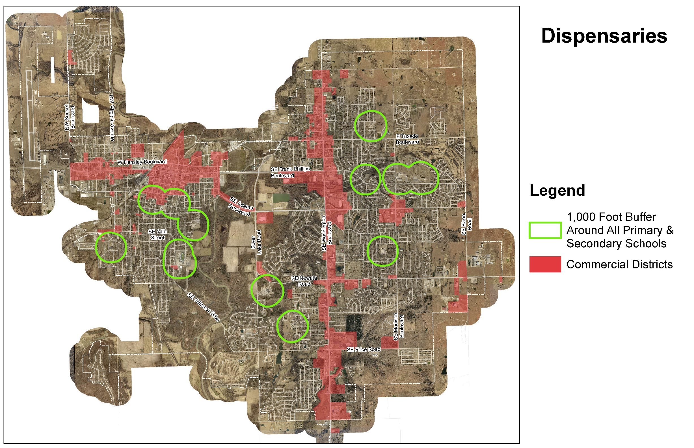

Slide 23
Proposed City Ordinance
Municipal Code, Chapter 12, Offenses
Adopts State Statutes and Rules as now approved or hereinafter approved
Establishes regulations for cultivation of medical marijuana for person medical use
Must be in patient license holders legally zoned and occupied full-time permanent private residence
All homegrown plants shall be accessible only to patient or caregiver
If grown outdoors, plants shall be enclosed on all sides by a 6-foot opaque fence or wall secured at all times with a commercial quality lock and key that is accessible only to the patient or caregiver
No plants, whether grown indoors or outdoors, shall be visible from any street or public right-of-way
If residence is rented, requires consent of the property owner

Slide 24
Proposed City Ordinance
Smoking or vaping of medical marijuana products shall be prohibited or restricted in the same manner as tobacco as follows:
  In any location set forth by State law or rule;
  Within any enclosed indoor City-owned facility or within 25’ of the entrance thereto;
  Within the following locations of a city park or recreation facility:
    In or within 50-feet of any playground or play court;
    In or within 50-feet of the fenced confines of any outdoor recreational facility;
    In or within 50-feet of bleachers and stands used by spectators at public events;
    On the travel or walking surface of the Pathfinder Parkway Trail system or within 5-feet thereof and in the associated trailheads.

Slide 25
Proposed City Ordinance
Defines public intoxication: Any person under the influence of medical marijuana or any other medical marijuana product at a level that presents a danger to others or creates a disturbance of the peace in or upon any public or private road, in any vehicle, any public place or building, at any public gathering, or place accessible to the public or open to being viewed by others.
Non-Medical Marijuana: “possession, use, cultivation, distributions, or transportation” of non-medical marijuana or related paraphernalia remains illegal and is regulated under the Uniform Controlled Dangerous Substance Act.

Slide 26
Municipal Code, Chapter 18,
Taxation and Finance
Proposed City Ordinance
Retail sales of medical marijuana, medical marijuana-derived products, and related paraphernalia shall be subject to the City’s sales tax of 3.4%, to be collected at the point of sale

Slide 27


Slide 28
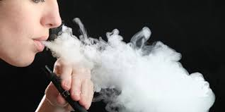

SMOKING AND VAPING
Smoking in Public Places and Indoor Workplaces Act
Regulates smoking of tobacco and tobacco products with a lighted cigar, cigarette, pipe or other lighted smoking device Medical
Medical Marijuana also regulated
Emergency Rules approved by Oklahoma Department of Health
All smokable, vaporized, vapable, and e-cigarette medical marijuana and medical marijuana products

Slide 29
Municipal Code, Chapter 12, Offenses
Sec. 12-120. - Smoking prohibitions.
Smoking in any enclosed, indoor facility owned by the City of Bartlesville is hereby prohibited.
For purposes of this section, "smoking“ means the carrying by a person of a lighted cigar,
cigarette, pipe, or other lighting smoking device.
This section shall not prohibit smoking in a private, enclosed room or office occupied exclusively by a smoker or smokers, eve if the room or enclosed office may be visited by a nonsmoker.
The city manager is authorized to promulgate and enforce reasonable rules and regulations not inconsistent with this section.

Slide 30
Proposed City Ordinance
Municipal Code, Chapter 12, Offenses
Adopts State Statutes and Rules as now approved or hereinafter approved
Provides definitions for “smoking device”, “smoke”, “smoking”, “tobacco product”, and “medical marijuana product” as follows:
    “Smoke” means the gases and particles released into the air by combustion, electrical ignition or vaporization, including from an Electronic Smoking Device, when the apparent or usual purpose of the combustion, electrical ignition or vaporization is human inhalation of the resulting gases, particles or vapor combustion products, such as, for example, tobacco smoke or marijuana smoke, except when the combusting material contains no tobacco, marijuana, or similar substance, and the purpose of inhalation is solely olfactory, such as, for example, smoke from incense.
    "Tobacco Product" means:
      Any substance containing or derived from tobacco leaf, including but not limited to cigarettes, Electronic Smoking Devices, cigars, pipe tobacco, hookah tobacco, snuff, chewing tobacco, dipping tobacco, blunts, clove cigarettes, or any other preparation of tobacco; and
      Any product or formulation of matter containing biologically active amounts of nicotine that is manufactured, sold, offered for sale, or otherwise distributed with the expectation that the product or matter will be introduced into the human body by inhalation; but does not include any cessation product specifically approved by the U. S. Food and Drug Administration for use in treating nicotine or tobacco dependence.
    “Medical Marijuana Product” means any substance containing or derived from cannabinoids, including concentrates, that have been extracted from plant material or the resin therefrom by physical or chemical means and is intended for administration to a qualified patient, including but not limited to oils, tinctures, edibles, pills, topical forms, gels, creams, forms medically appropriate for administration by vaporization or a nebulizer, patches, tinctures, and liquids excluding live plant forms.
“Smoking Device” shall mean a lighted cigar, cigarette, pipe, or other lighted or heated device, pipe, or product, including electronic or battery operated devices, intended for inhalation of a product in any manner or in any form, including but not limited to vaping, inhaling, exhaling or burning, whether natural or synthetic.
    “Smoking” means engaging in an act that generates Smoke, such as for example, but not limited to: possessing a lighted pipe, a lighted hookah pipe, a lighted cigar, an operating Electronic Smoking Device, a lighted cigarette of any kind or a lighted smoke inhalation device of any kind that generates Smoke, or the act of lighting or igniting a pipe, a hookah pipe, a cigar, a cigarette or Smoke inhalation device of any kind that generates Smoke.

Slide 31
Proposed City Ordinance
In addition to current regulation 12-120, adds the following areas where smoking is prohibited:
  Within 25-feet of the entrance or exit of any enclosed, indoor facility owned or under the control of the City of Bartlesville;
  Within City parks, parkways, trails, recreation areas, and open space lands
    In or within 50’ of a playground or play court
    In or within 50’ of the fenced confines of any outdoor recreational facility
    In or within 50’ of bleachers and stands used by spectators at public events; and
    On the travel or walking surface or 5-feet thereof of the Pathfinder Parkway Trail System and the associated trailheads

Slide 32
Municipal Code, Chapter 13,
Parks and Recreation
Proposed City Ordinance
Adds Smoking as a prohibited activity in city parks and recreational facilities in those areas just identified
Provides definitions a playground, play field, or play court as follows:
  A playground shall be defined as any portion of public park land that is designed and equipped with play structures such as swings, climbing structures, splash pads, water features or the like, primarily, but not exclusively, set aside for children’s play. This definition shall include a skateboard park.
  A play field or play court shall be defined as any portion of public park land that is designed, equipped, and prepared for playing of a game or match, such as soccer, football, baseball, softball, tennis, volleyball, or the like, either fenced or unfenced, that is used for recreational or competitive play.

Slide 33

Notes:
Additional amendments are recommended to clearly cover the smoking or vaping of medical marijuana products.

Slide 34
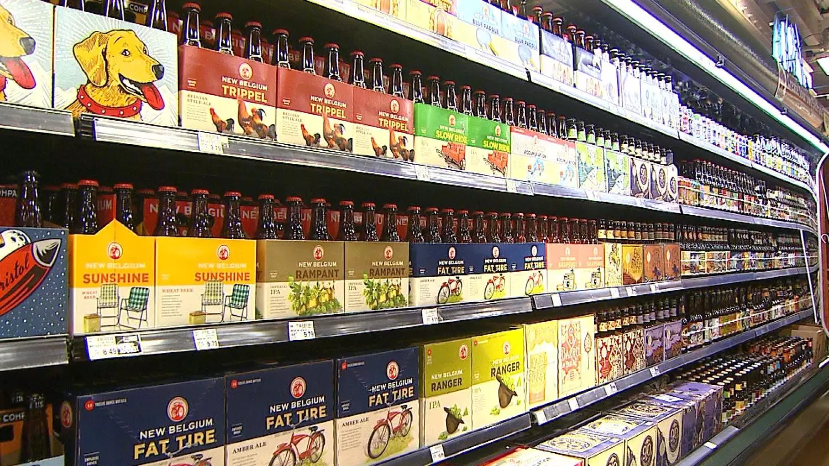
ALCOHOL MODERNIZATION LAWS
Sales of refrigerated full-strength beer (up to 8.99% ABV) and wine (up to 15% ABV) in grocery stores, convenience stores, & similar retail stores
Essentially does away with “low-point beer” and other non-intoxicating beverages
Begins Monday, October 1, 2018 at 6:00 a.m.

Slide 35
Other Significant Changes in the Law
Liquor stores will be the only retailer permitted to sell spirits, but they will also be able to sell refrigerated beer and wine.
Liquor stores will also be the only retailer permitted to sell beer in excess of 8.99% ABV and wine in excess of 15% ABV.
Wine and spirits stores will be able to sell items other than alcohol (i.e. products you could normally find in a grocery or convenience store), provided those sales don’t exceed 20% of monthly sales.
Off-premises consumption locations, like grocery stores and convenience stores, can sell from 6:00 a.m. to 2:00 a.m. on any day.
Liquor stores will be able to open at 8:00 a.m. and sell until midnight, Monday through Saturday. Previously, such stores were only allowed to be open from 10:00 a.m. to 9:00 p.m. Sunday’s are still off limits for liquor stores unless changed by the County Commissioners with voter approval.

Slide 36
On-premise consumption locations, such as restaurants and bars, may serve alcohol between 8:00 a.m. and 2:00 a.m. on any day.
The 300-foot buffer area (from schools or churches) currently required for mixed-beverage and wine bars, and package liquor stores remains in place and will now apply to new beer bars as well. Previously this buffer did not apply if the beer bar sold 3.2% or less. Existing low-point beer bars will be grandfathered.
300-foot buffer area does not apply to restaurants that serve alcohol; required for any establishment “which has as its main purpose the selling or serving of alcoholic beverages for consumption on the premises; or package liquor stores

Slide 37
Municipal Code,
Chapters 5, 12, 13, and 18
Proposed City Ordinance
Removes all references to low-point beer or non-intoxicating beverages
Adopts State Statutes and Rules as now approved or hereinafter approved
Defines Alcoholic Beverages as all beverages which contain alcohol
Updates license categories and fees as per Oklahoma Statutes
Provides that City licenses will expire on June 30th of each year in conjunction with business licenses
Sets forth the hours of operation for license holders as set forth by State law
Maintains the 300-foot setback for on premise consumption and liquor stores
Provides definitions for open container and public property
Addresses drinking, possession and transportation on public property
Addressed drinking and possession on private property
Updates definition of public intoxication
Provides for an interim period to purchase, stock, and store only until October 1, 2018

